Slide 1
Lloyd McKenzie, Gevity Consulting
FHIR Design Considerations

Slide 2

Who I am
Name: Lloyd McKenzie
Company: Gevity
Background:
One of FHIR’s 3 initial editors
Co-chair FMG & FHIR Infrastructure
Co-chair HL7 Modeling & Methodology
Heavily involved in HL7 and healthcare exchange for last 20 years
v2, v3, CDA, etc.
Have created 10+ IGs for various projects using HL7 tools
lmckenzie@gevityinc.com

Slide 3


Creative Commons - Attribution
Download, use as you wish, just thank HL7 (and maybe me)
You might also enjoy “Flicker or Bonfire” – my architecture presentation from last year

Slide 4
What I talked about last year
1. Use REST whenever you can
2. Create permissive interfaces
3. Don’t lock into “the way we’ve always done it”
4. Think about the community
In short: “Try not to be a ‘special snowflake’”

Slide 5
What I talked about last year
1. Use REST whenever you can
2. Create permissive interfaces
3. Don’t lock into “the way we’ve always done it”
4. Think about the community
In short: “Try not to be a ‘special snowflake’”

Slide 6

Context for this presentation
20+ Implementation Guides
Different approaches
Questions about why approach chosen
Needed a better answer than “because that’s what we decided”
Undertook a deep analysis of what the options were and what should be used when

Slide 7
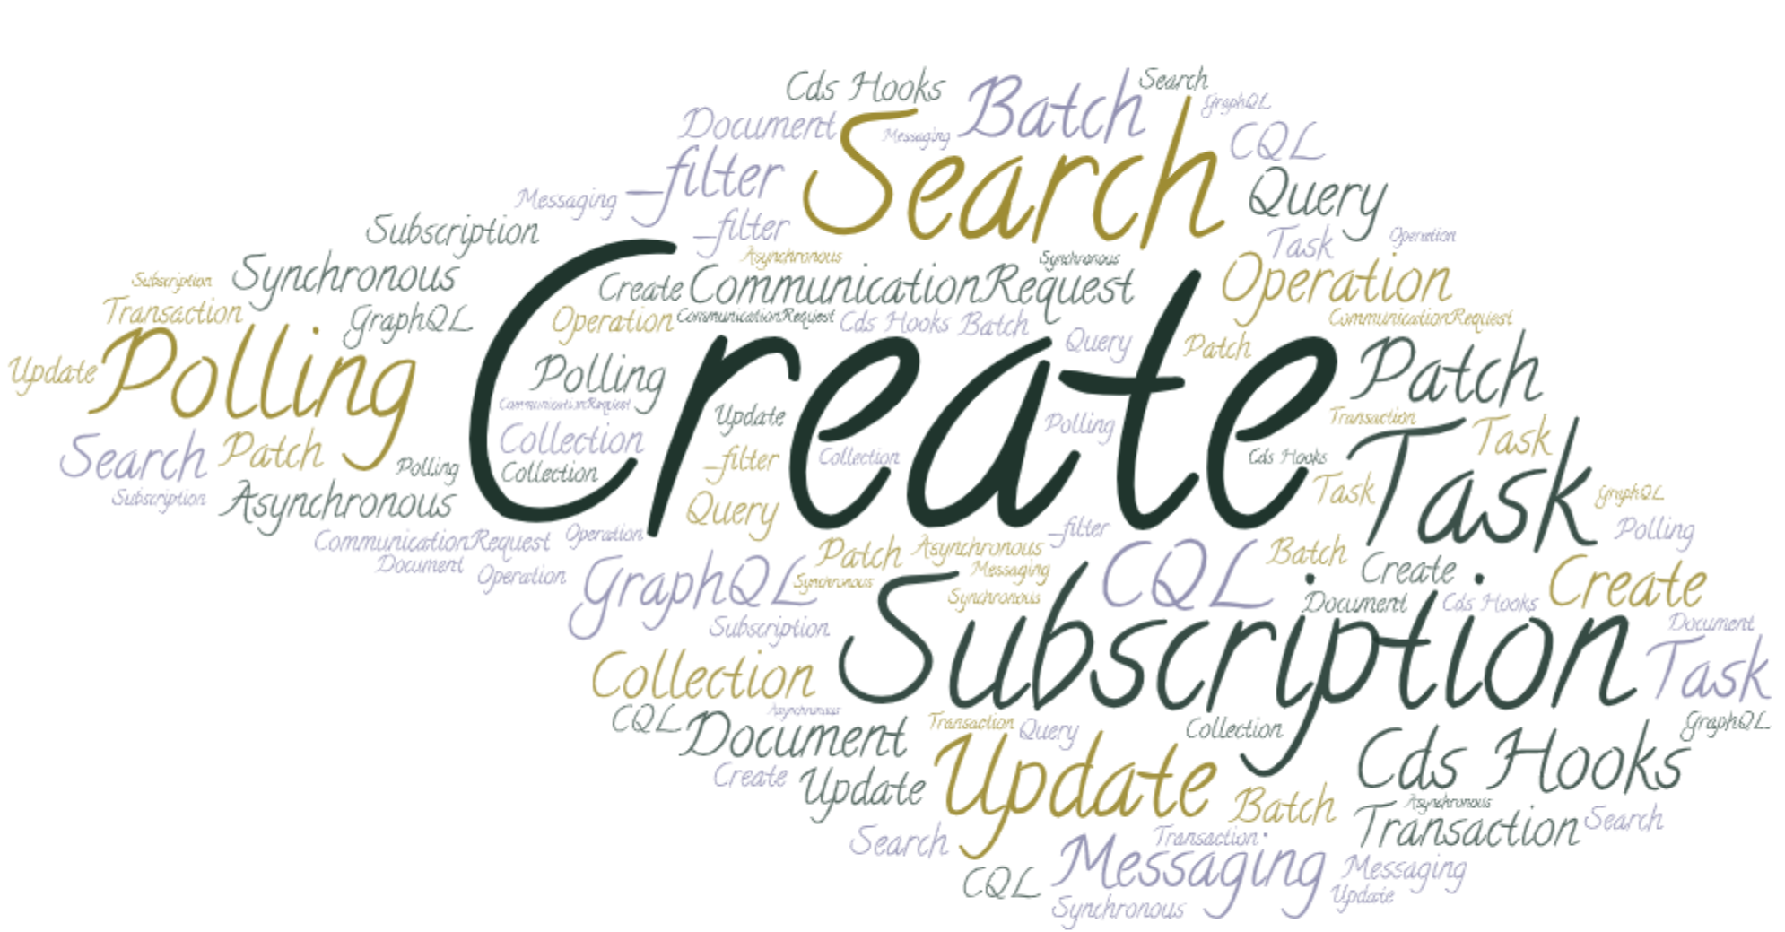
FHIR defines a LOT of ways to share data
21 in total
Or more…
Notes:
Asynch vs. synchronous
Workflow approaches for Task/CommunicationRequest
Only those defined by HL7 international (so not SQL-on-FHIR)

Slide 8
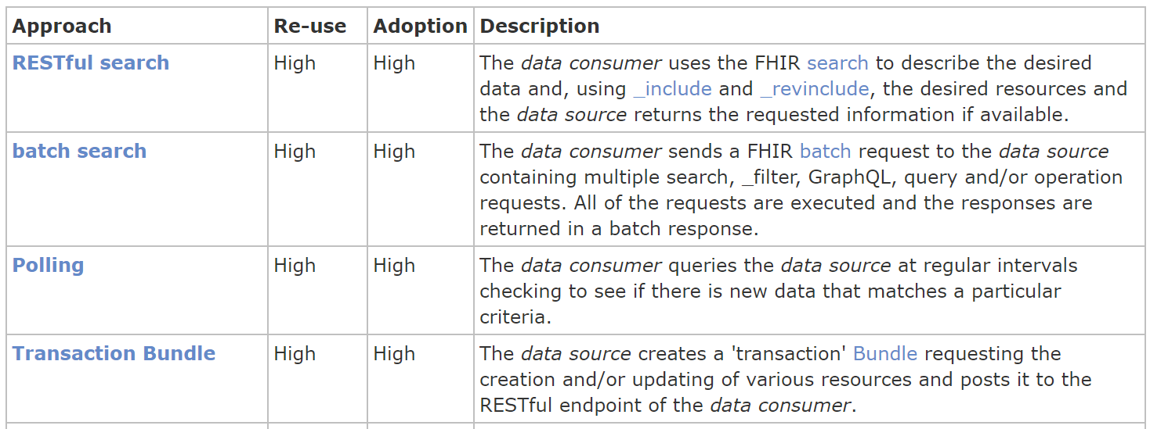
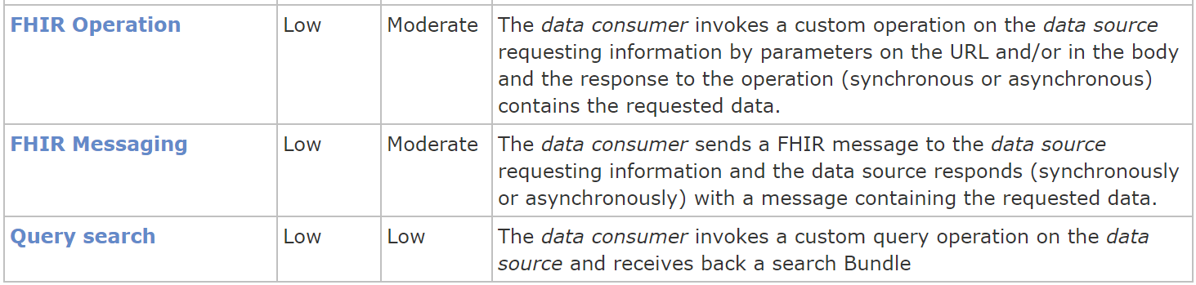
So – how to choose?
How re-useable / multi-purpose?
How widely adopted?
…

Slide 9
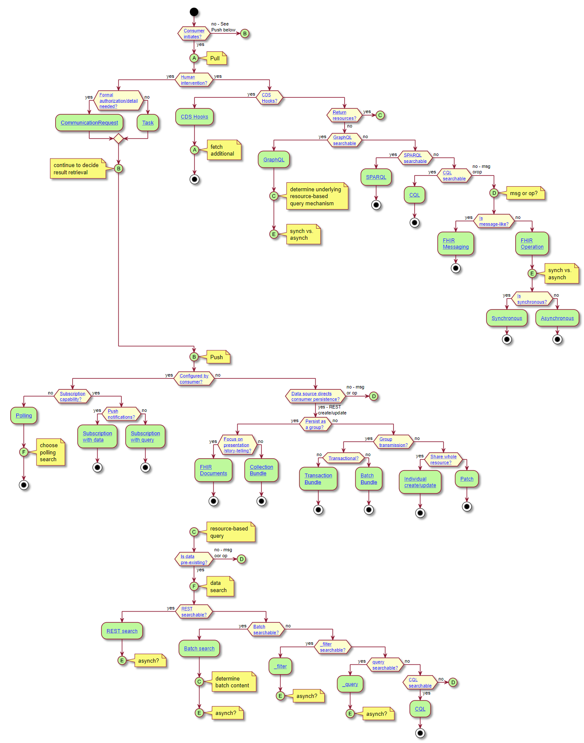
How to choose
What’s your use-case?

Slide 10
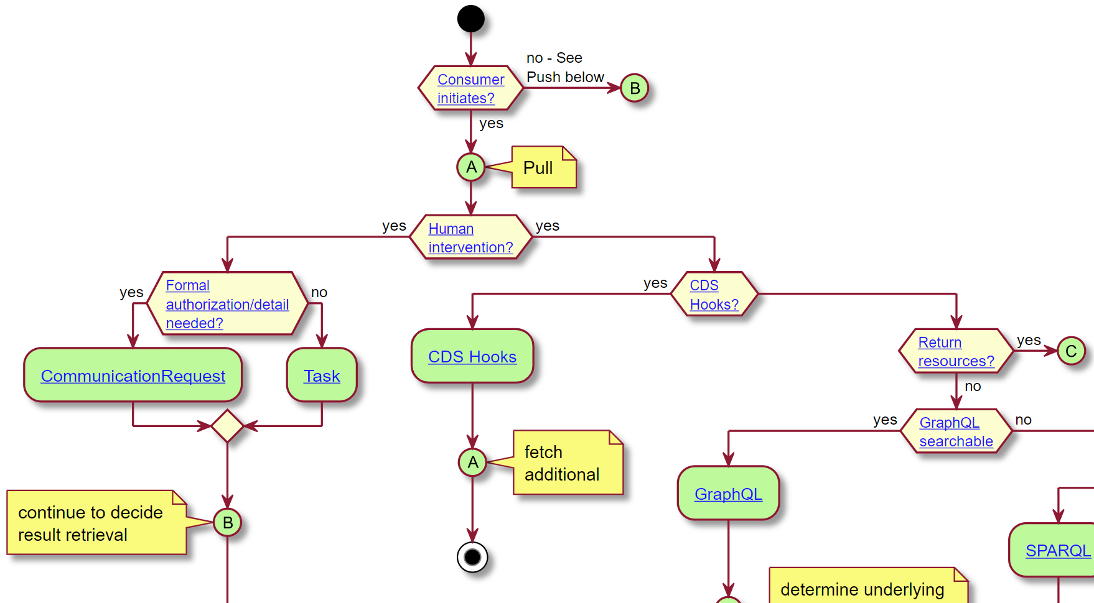

Slide 11
Some caveats
Informative, not normative
Other factors will matter
Legacy capabilities
Existing infrastructure
Internal architecture conventions
Personal preference
What do your partners support?

Slide 12
Key decision points
Pull vs. push
Are humans involved?
Are you retrieving resources or data elements?
Is push ‘consumer-configured’?
Does source direct persistence?
Does data already exist?
Store as a collection or individually?
Synchronous or asynchronous?
Notes:
Polling is still ‘push’

Slide 13
What technology will work?
Pull resources
Search, batch search, _filter, _query, CQL, operations, messaging
Pull data elements
GraphQL, SPARQL, CQL, Operations, Messaging
Consumer-directed push
Polling, Subscription – notification, Subscription w/ data
Source-directed push
REST create/update, Batch, Transaction, Patch, Document, Collection, Operation, Message

Slide 14
Where is this work going?
Reviewed and discussed by various work groups
Initial publication in Davinci HRex IG sometime this summer
All Da Vinci IGs will reference
Will also explain tree navigation rationale
Encourage other IGs to do the same
Intent is to migrate into FHIR R5 when it comes out
Work in progress will be here:
https://build.fhir.org/ig/HL7/davinci-ehrx/exchanging.html

Slide 15



Questions / Discussion
lmckenzie@gevityinc.com
Or, better yet, include the community and ask/discuss on chat.fhir.org

Slide 16



